Slide 1

Introduction To AI (AI101B) THE PHENOMS
RESUME SCREENING USING NLP
Vidushi Agrawal 2426MCA316,
Yashvi Chaudhary 2426MCA2207
Vaibhav Singh Kalura 2426MCA2325
Vaishnavi Yadav 2426MCA196
Project Supervisor:
Mr. Apoorv Jain
Assistant Professor

Slide 2

Resume Screening Using NLP and Transformers
An automated system to improve hiring efficiency and fairness.

Slide 3
Challenges in Traditional Resume Screening
Manual Screening
Keyword Filtering
Time-consuming and inconsistent, with unconscious bias risks.
Fast but lacks context, prone to false positives and negatives.
Average resume review time: 7.4 seconds.
Candidates may game the system with keyword stuffing.

Slide 4
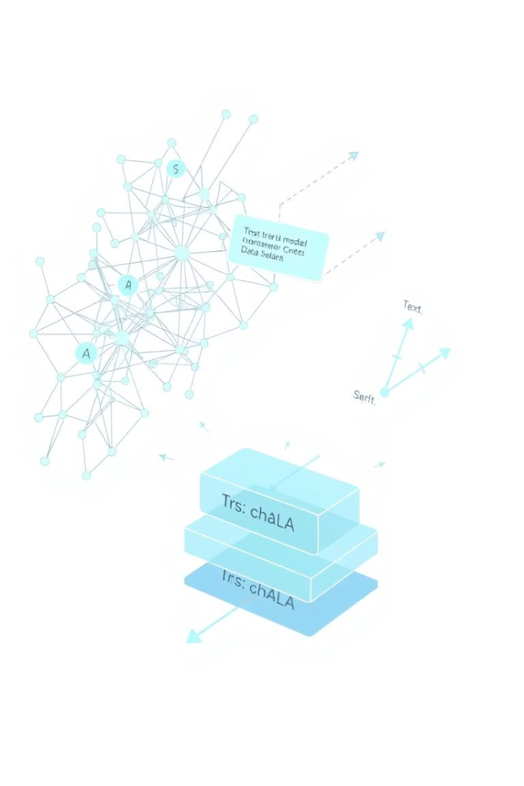
Rise of Intelligent Automation
Natural Language Processing
Transformer Models
Use self-attention to capture context and relationships in text.
Enables semantic understanding beyond keywords.
BERT
Bidirectional encoding for deep contextual embeddings.

Slide 5
Resume Screening Pipeline
Data Collection
Parsing & Preprocessing
Embedding & Matching
Ranking & Deployment
Gather resumes, job descriptions, and labeled hiring data.
Extract structured info and clean text for modeling.
Convert text to vectors and score candidate-job fit.
Rank candidates and integrate into recruitment systems.

Slide 6

Resume Parsing Techniques
Rule-Based Parsing
Uses patterns and regex; fast but format-dependent.
Machine Learning Parsing
NER and classical ML models for flexible extraction.
Deep Learning Parsing
RNNs and transformers capture complex context.
Hybrid Approaches
Combine rules and ML for precision and adaptability.

Slide 7





Applications of NLP in Resume Screening
Automated Filtering
Skill Matching
Candidate Ranking
Diversity Initiatives
Identifies relevant skills and competencies accurately.
Speeds up candidate shortlisting with semantic analysis.
Prioritizes candidates based on fit scores.
Supports unbiased screening and blind recruitment.

Slide 8
Resume Parsing Tools & Libraries
PyResparser & Affinda
SpaCy & NLTK
Hugging Face Transformers
TensorFlow
NLP frameworks for tokenization and entity recognition.
Deep learning framework supporting transformer training.
Python libraries for structured resume extraction.
Pretrained models like BERT for embedding and classification.

Slide 9





Prototype Development Steps
Define Scope
Focus on key roles and manageable datasets.
Data Preparation
Collect and preprocess resumes and job descriptions.
Model Fine-Tuning
Adapt BERT for resume-job matching tasks.
UI & API
Build interfaces for uploading and viewing results.
Testing & Iteration
Validate performance and improve system continuously.

Slide 10

Conclusion & Future Scope
Conclusion
Future Directions
NLP and transformers enhance accuracy, fairness, and efficiency.
Multimodal data, explainability, bias mitigation, and multilingual support.
Impact
Transform recruitment with scalable, inclusive, and data-driven hiring.

